Slide 1
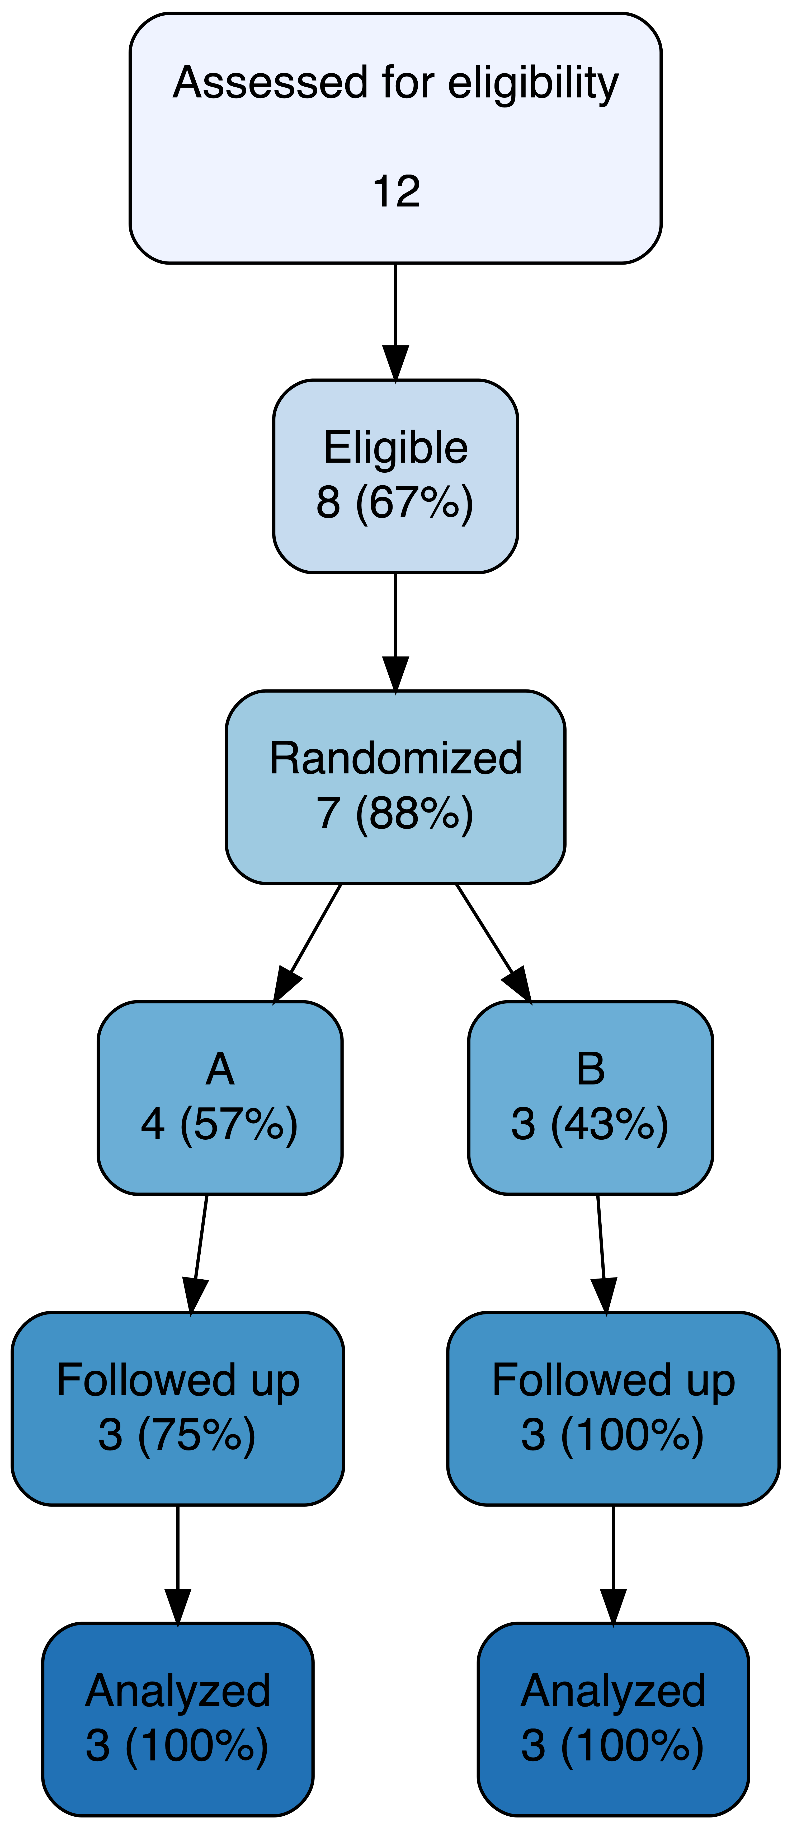
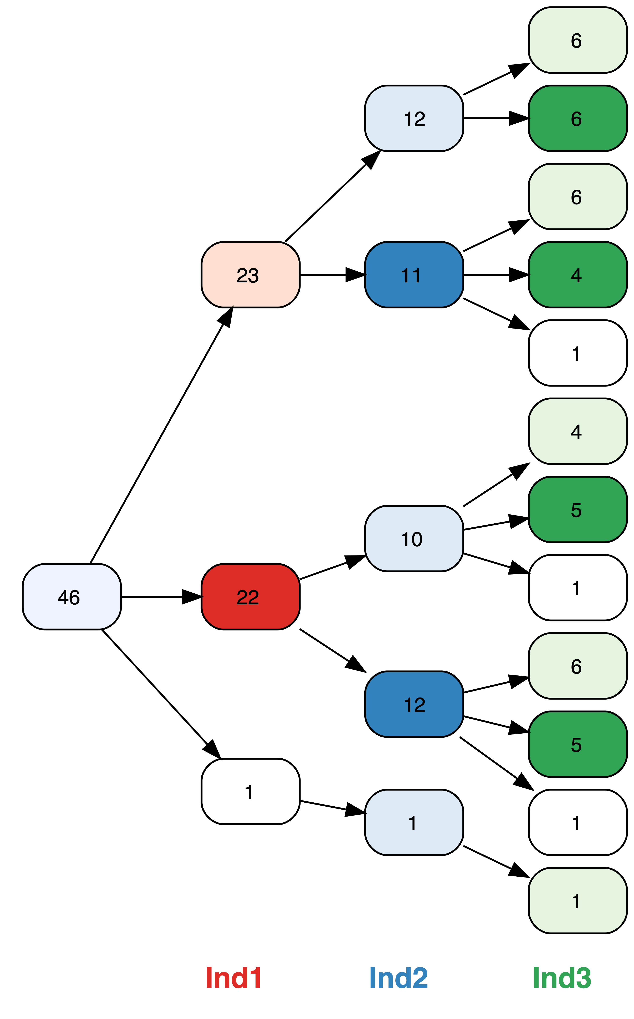
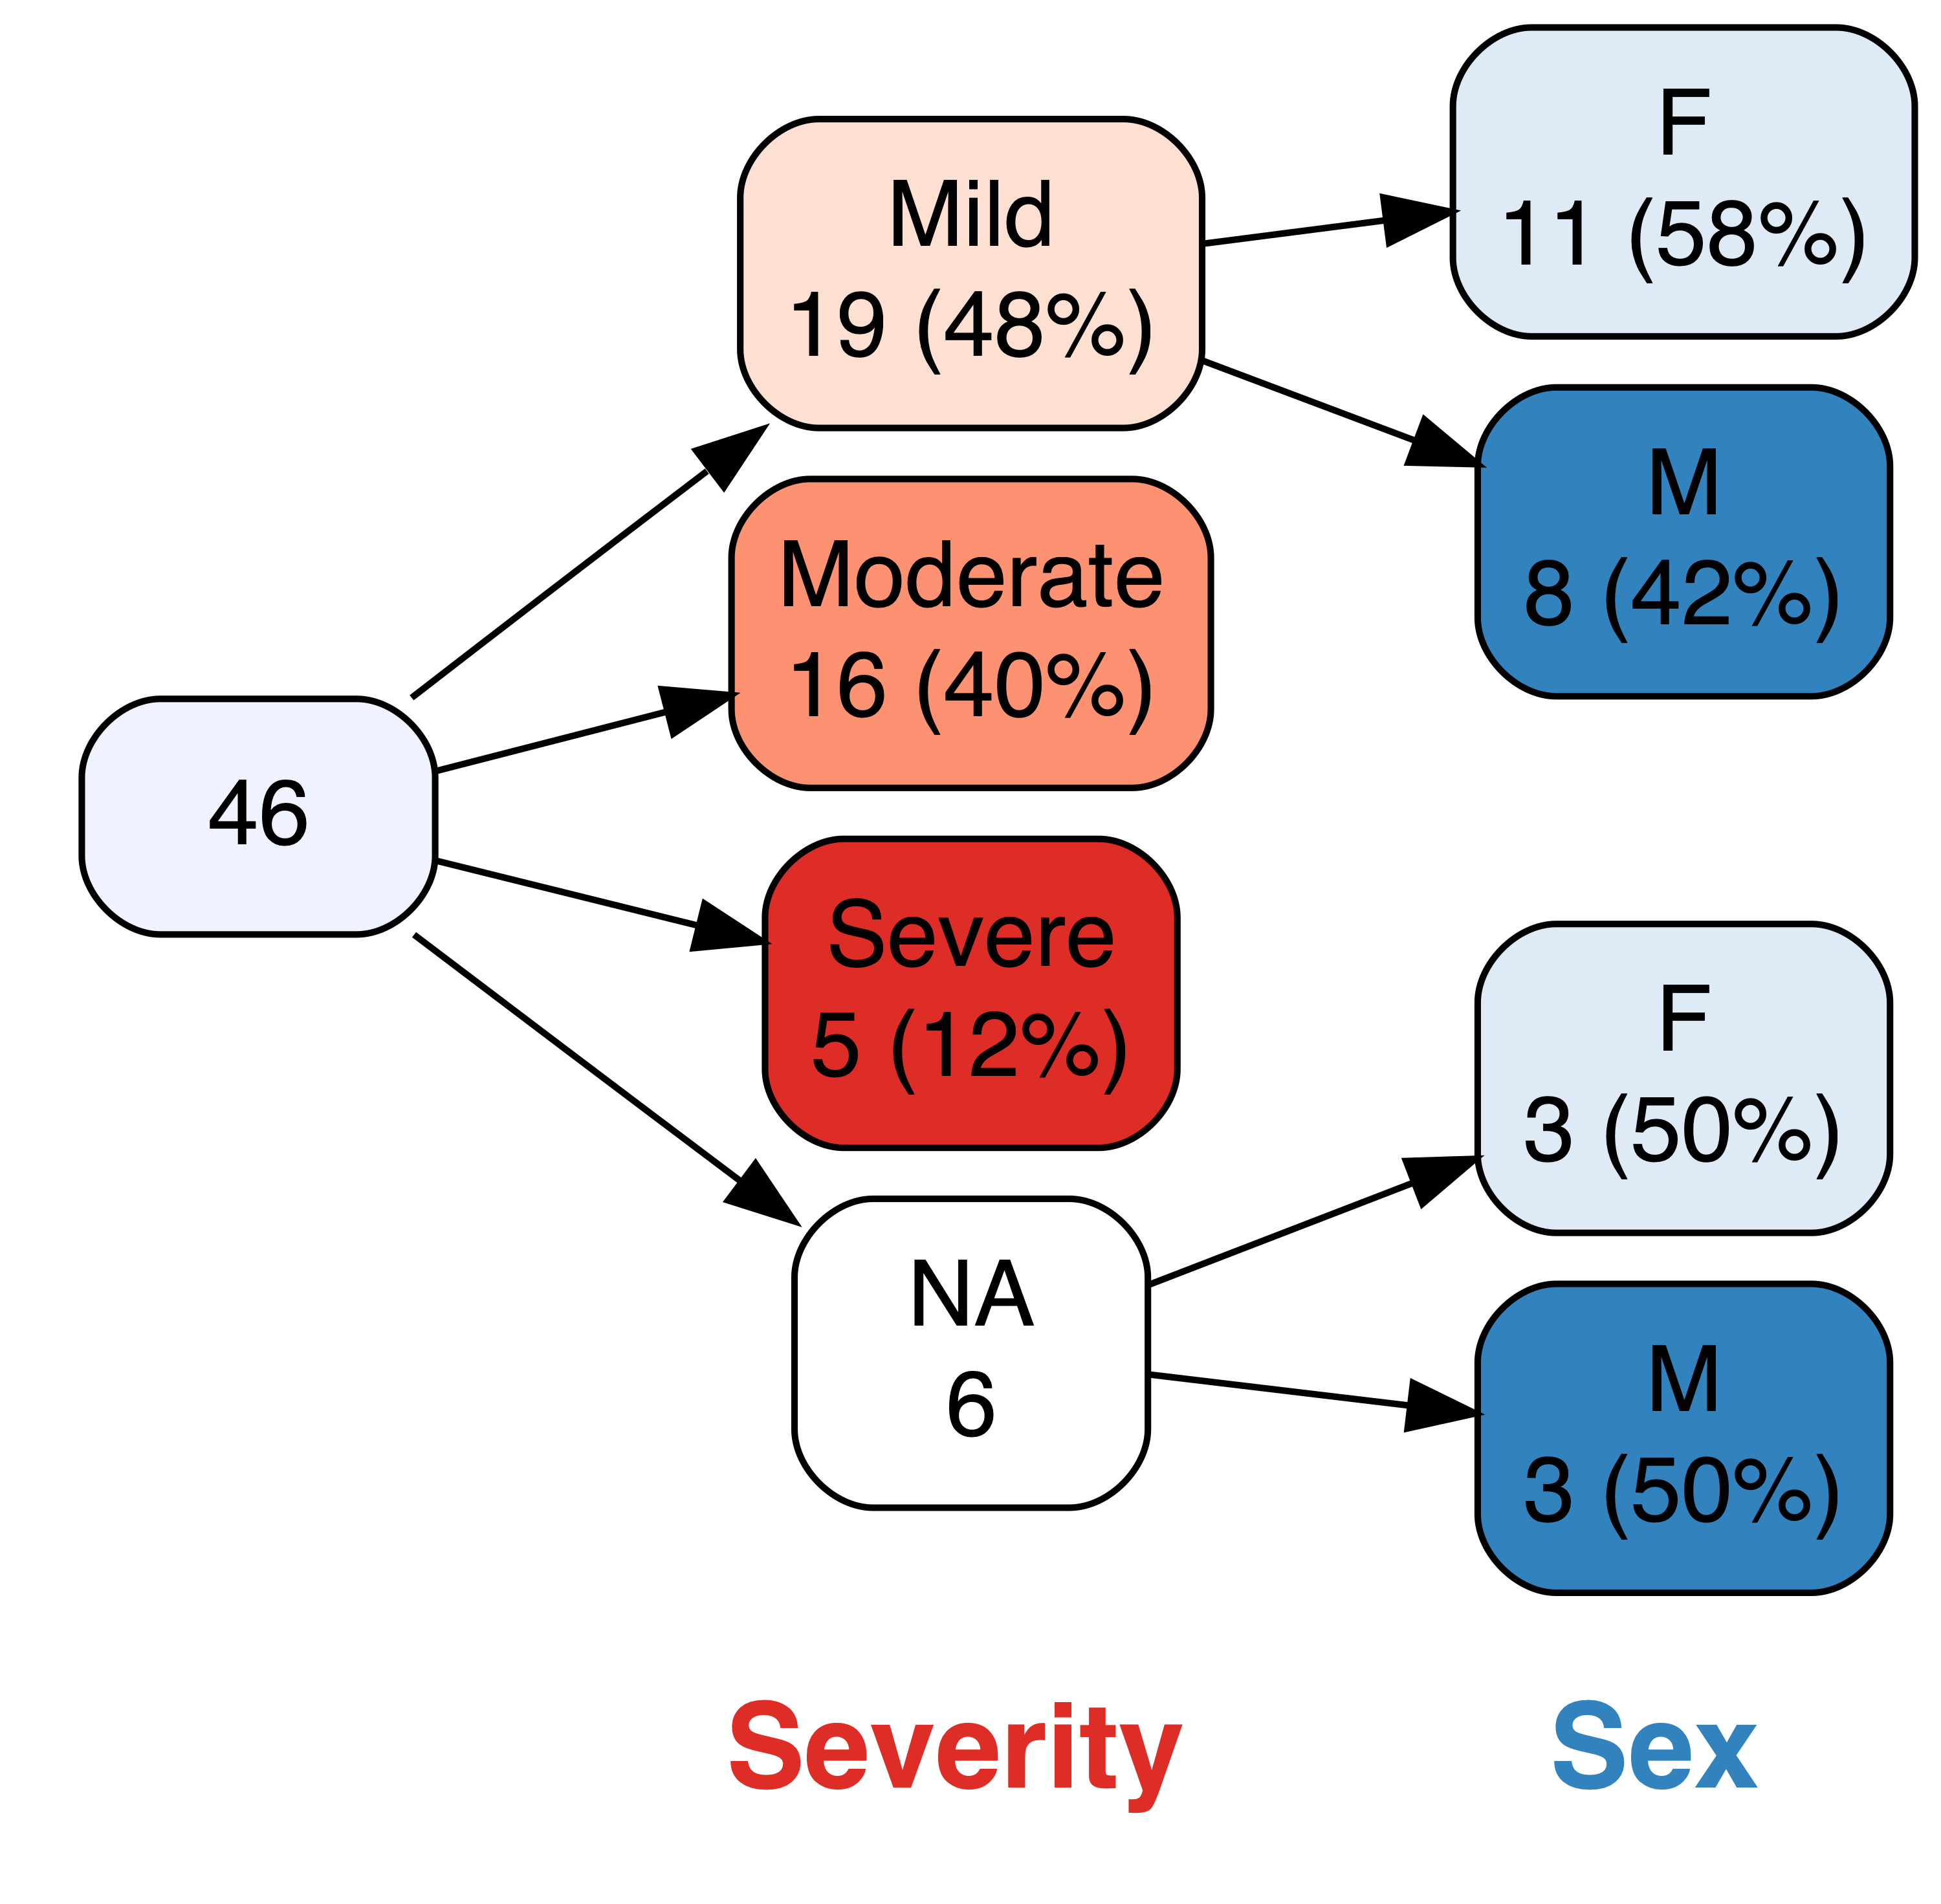


vtree
An R package for drawing variable trees
Nick Barrowman, PhD
Children’s Hospital of Eastern Ontario Research Institute
Faculty of Medicine, University of Ottawa

Slide 2

Nick Barrowman, PhD
Senior Statistician
Clinical Research Unit
Children’s Hospital of Eastern Ontario Research Institute

Slide 3


Slide 4
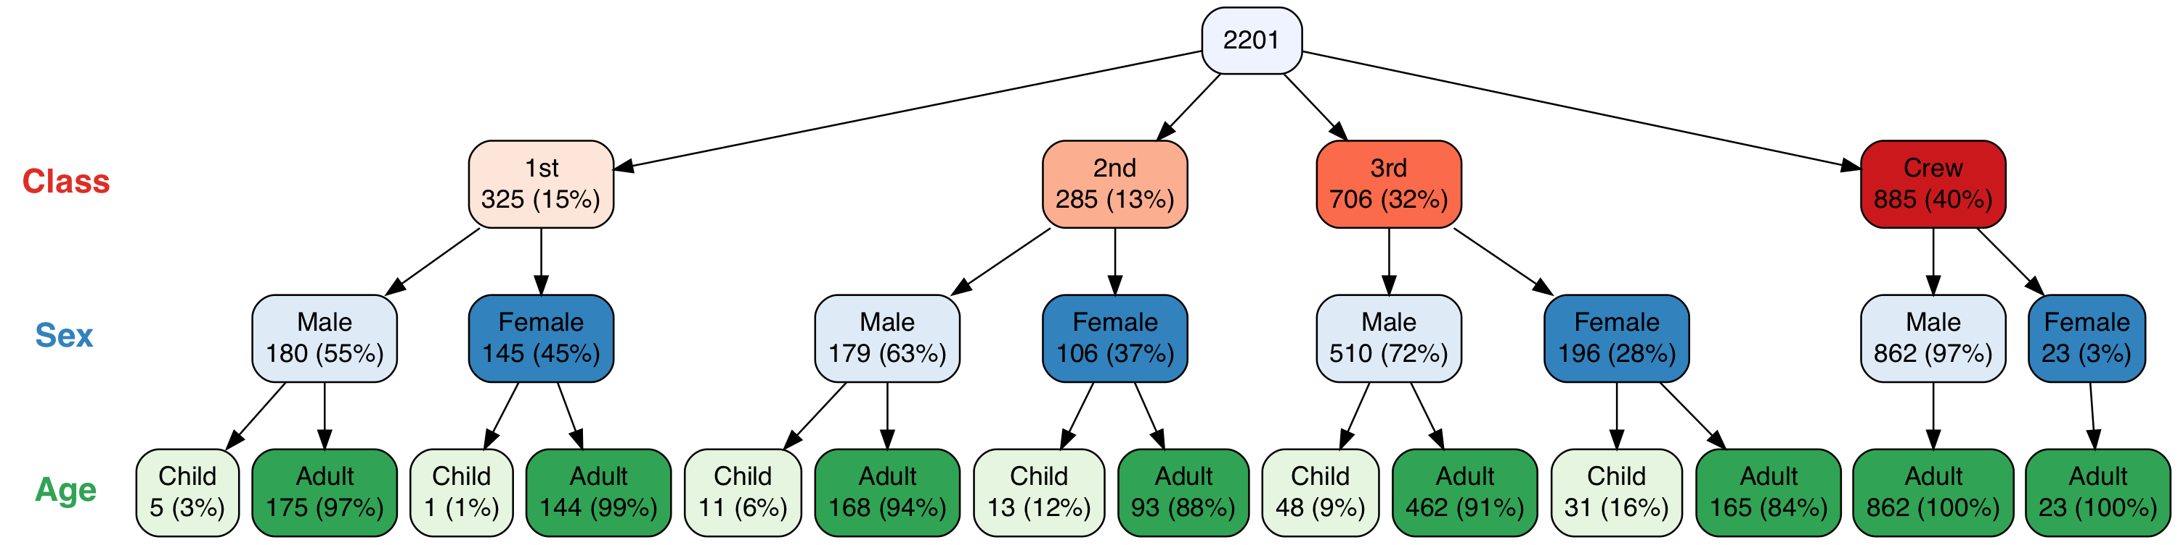
vtree(titanic,"Class Sex Age",horiz=FALSE)

Slide 5
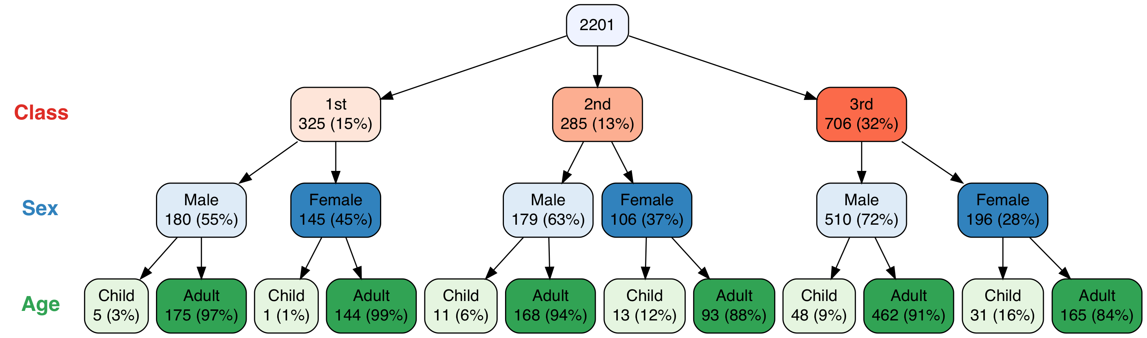
vtree(titanic,"Class Sex Age",horiz=FALSE,prune=list(Class="Crew"))

Slide 6
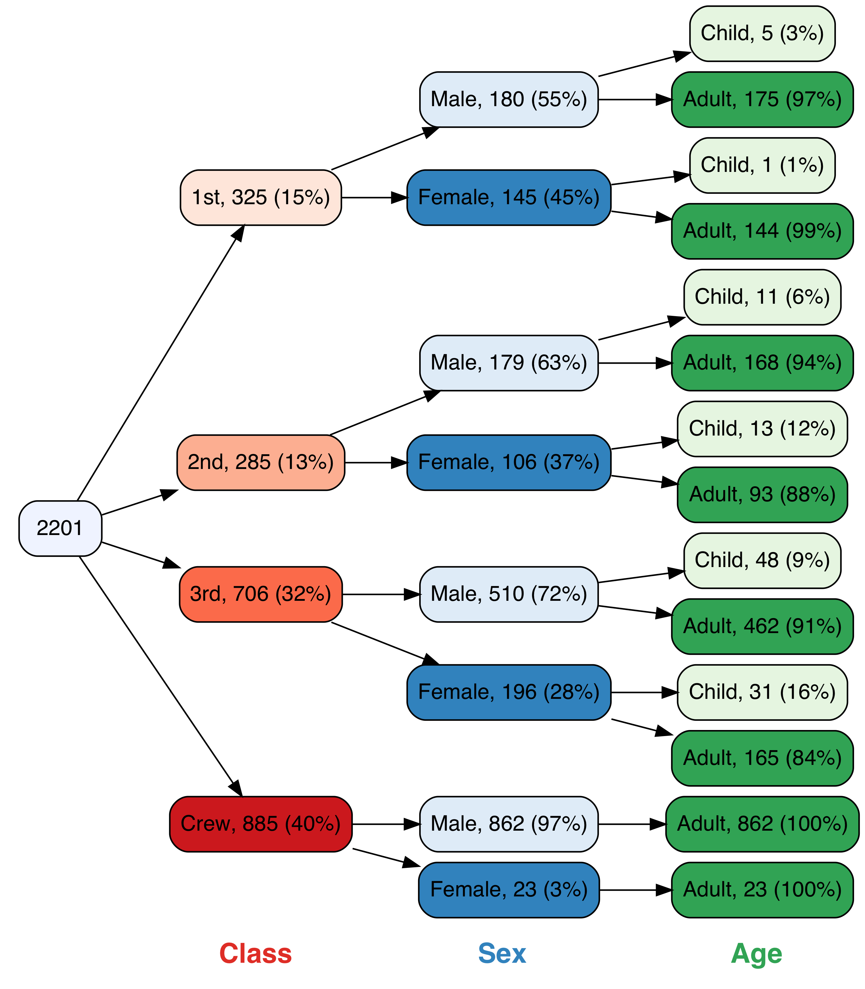
vtree(titanic,"Class Sex Age",sameline=TRUE)

Slide 7
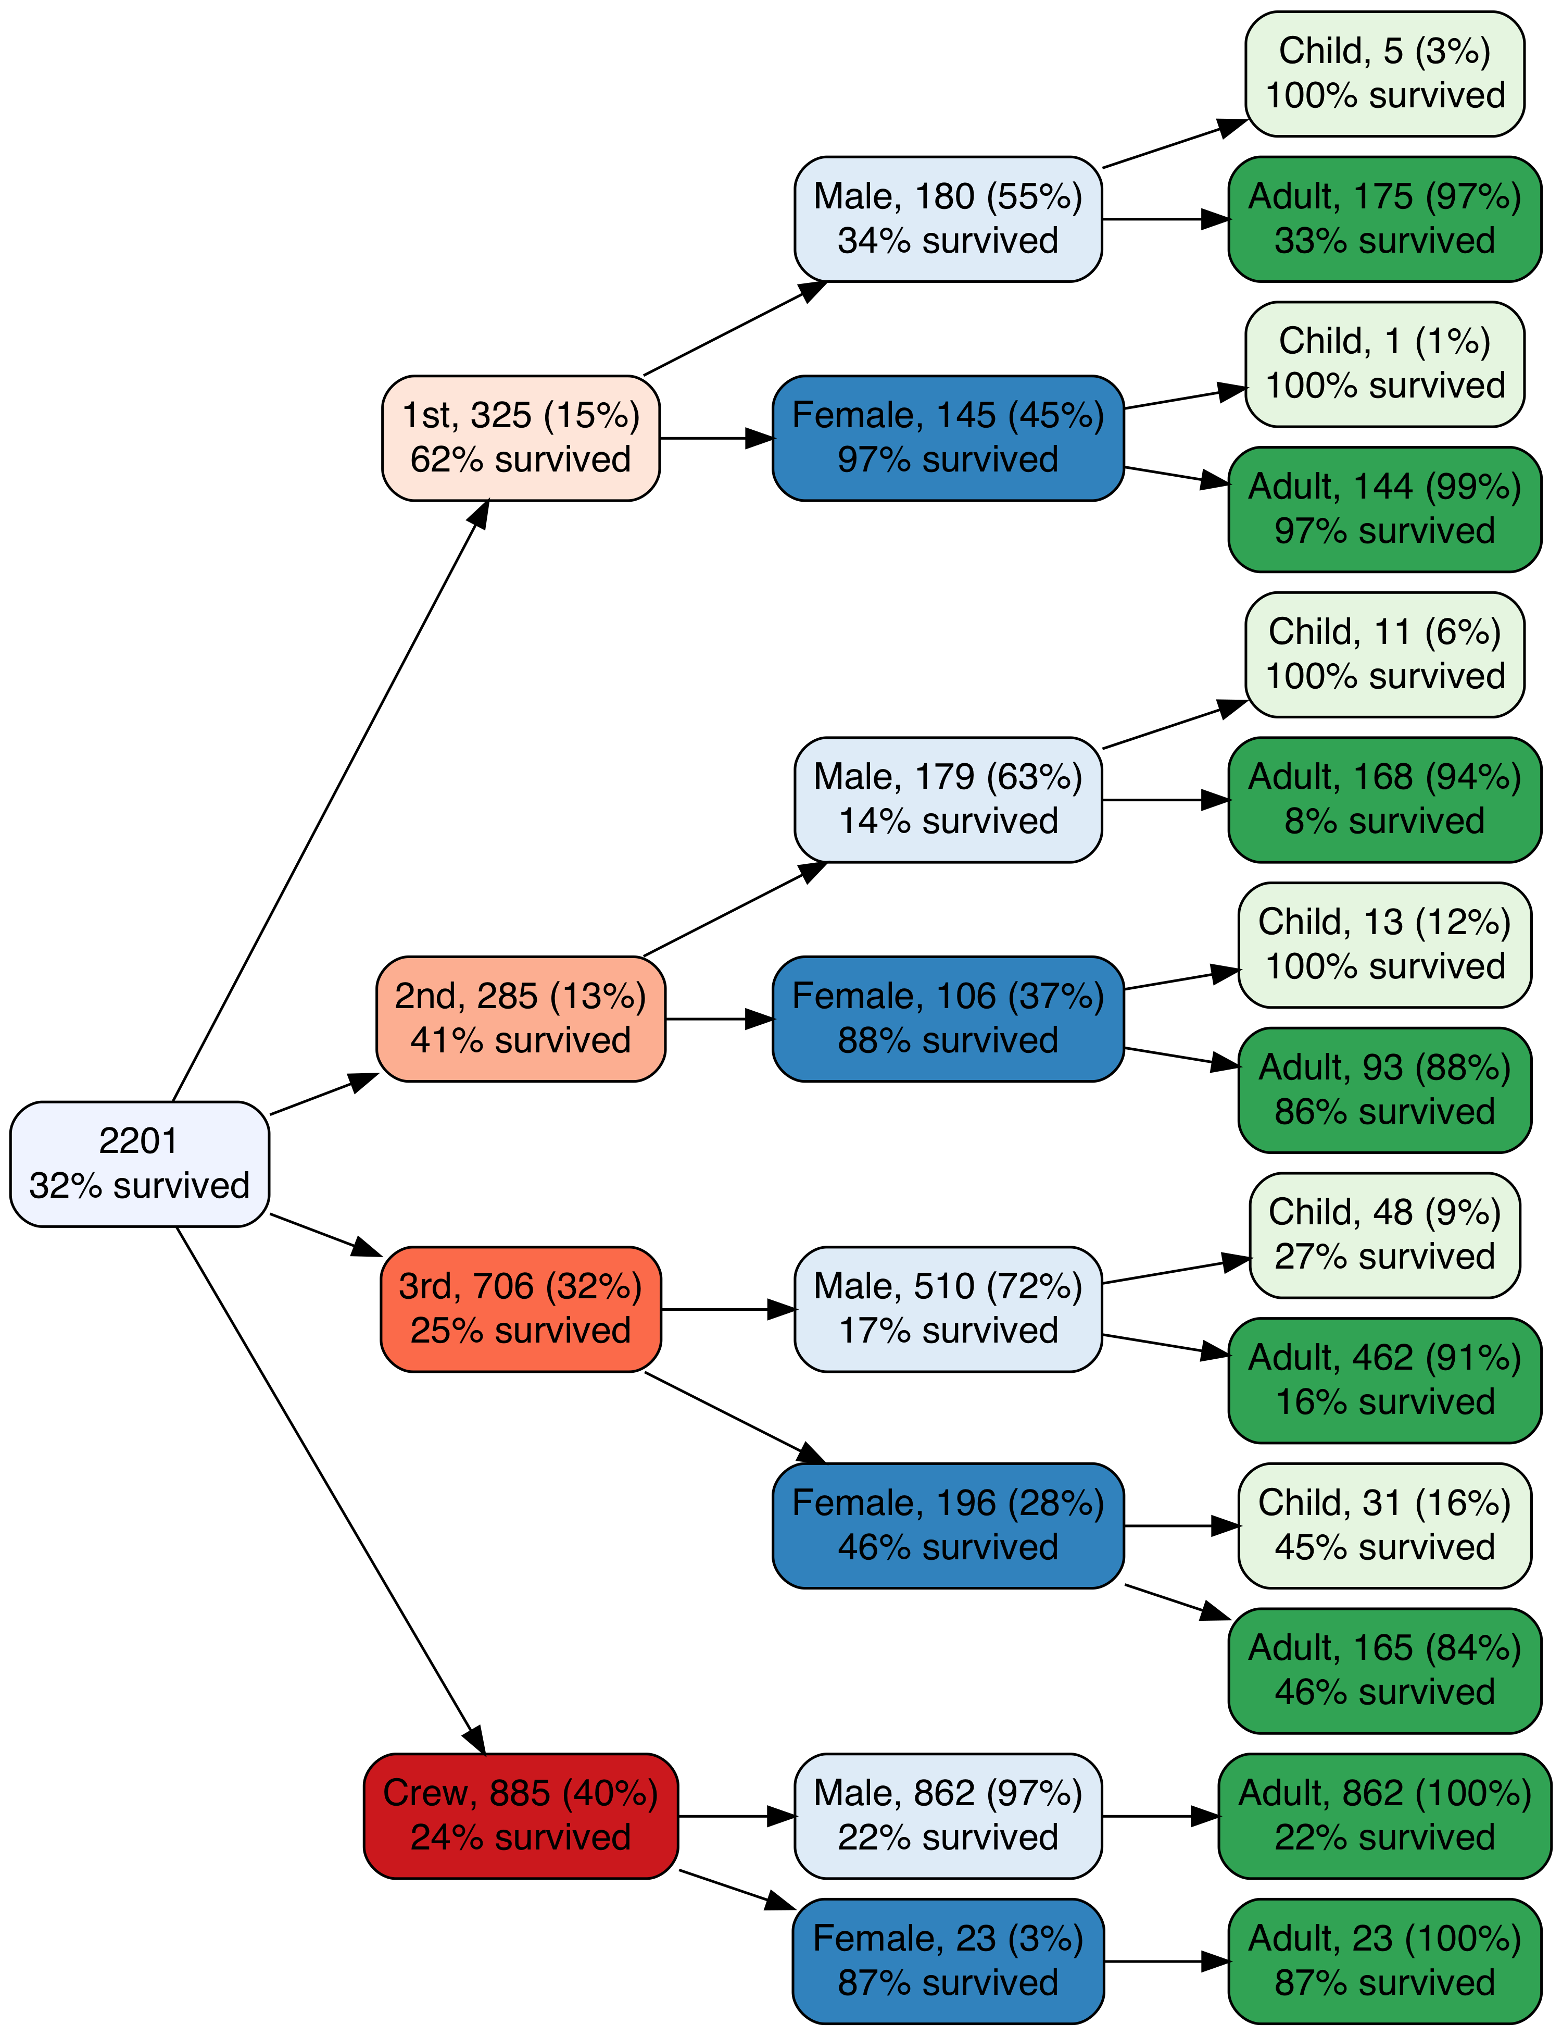
vtree(titanic,"Class Sex Age",sameline=TRUE,
summary="Survived=Yes \n%pct% survived",
showvarnames=FALSE)

Slide 8
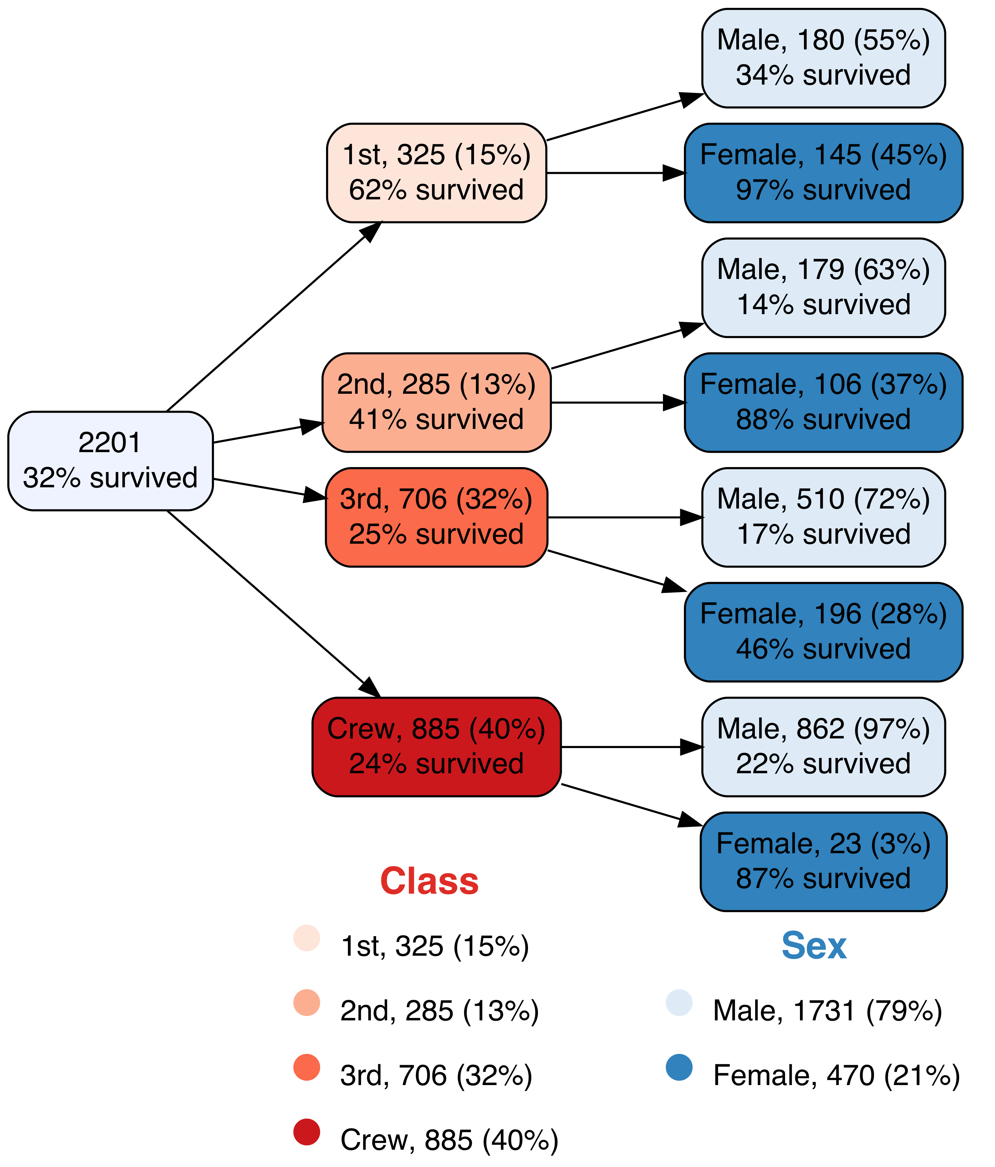
vtree(titanic,"Class Sex",sameline=TRUE,
summary="Survived=Yes \n%pct% survived",
showlegend=TRUE)

Slide 9
Data from http://biostat.mc.vanderbilt.edu/DataSets

Slide 10
19 variables on 403 participants
id | location | gender | frame | age | whratio | glyhb
1000 | Buckingham | female | medium | 46 | 0.7631579 | 4.31
1001 | Buckingham | female | large | 29 | 0.9583333 | 4.44
1002 | Buckingham | female | large | 58 | 0.8596491 | 4.64
1003 | Buckingham | male | large | 67 | 0.8684211 | 4.63
1005 | Buckingham | male | medium | 64 | 1.0731707 | 7.72

Slide 11
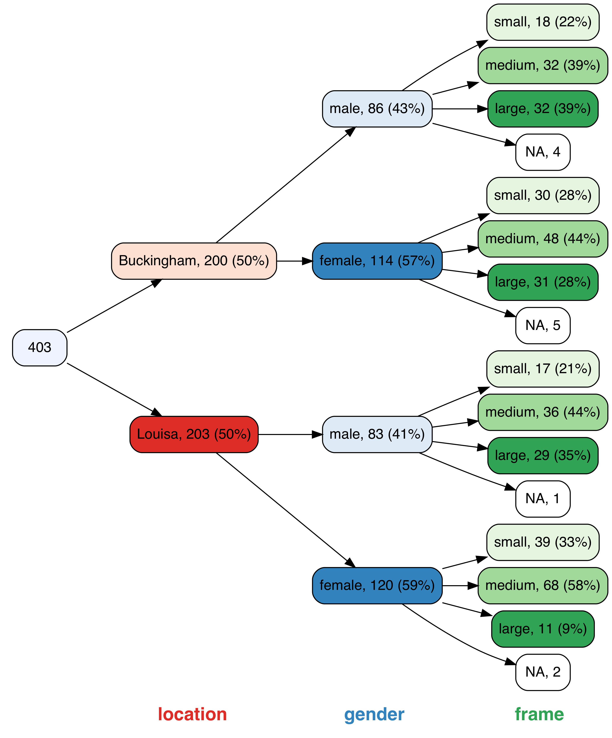
vtree(diabetes,"location gender frame", sameline=TRUE)

Slide 12
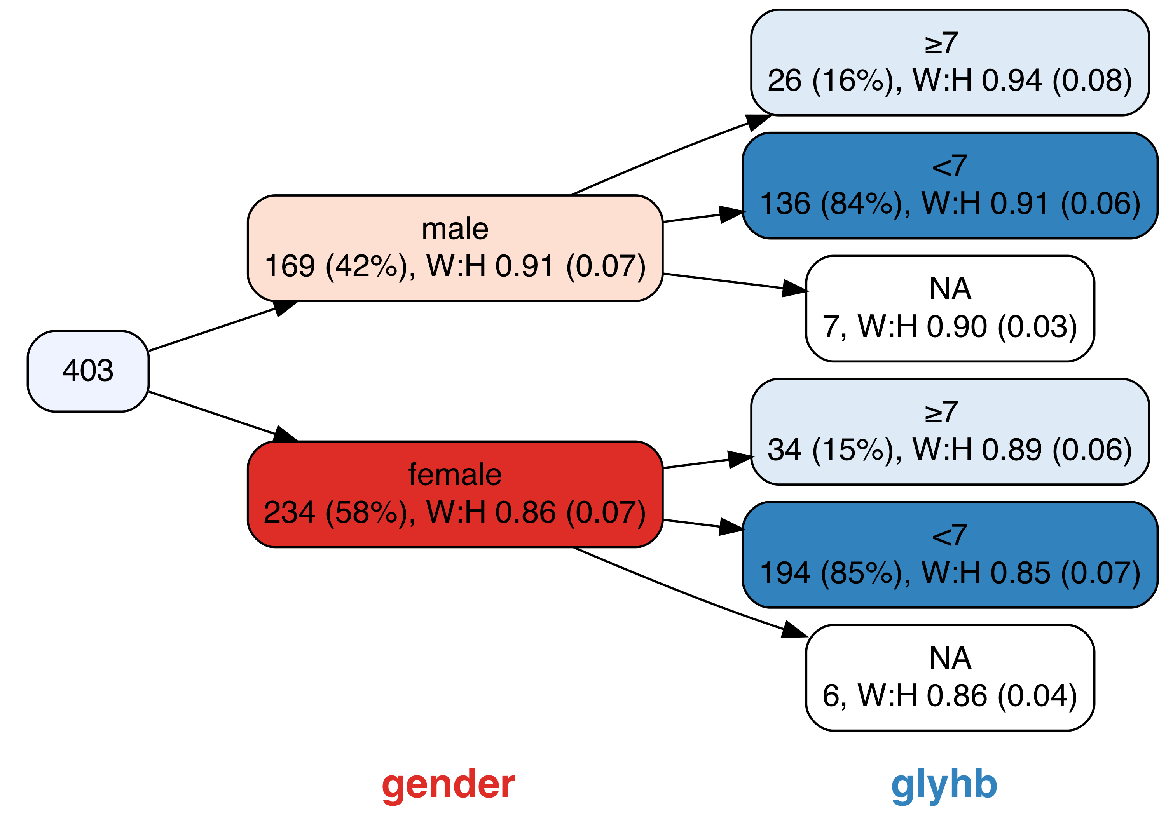
vtree(diabetes,"gender glyhb<7",
summary="whratio , W:H %mean% (%SD%)%noroot%",
cdigits=2)

Slide 13
Thank you!
Acknowledgments
vtree is built on the DiagrammeR package, which uses the Graphviz software with the htmlwidgets framework. The CRAN team and the R Foundation make it easy for developers to share their R packages. I’d also like to thank my colleagues at the CHEO Research Institute.
vtree 2.0.0 is now available on CRAN
Nick Barrowman
nbarrowman@cheo.on.ca
github.com/nbarrowman/vtree

